Slide 1

An Evening of DSLs: ‘Oslo’
James Lynch

Slide 2

What is Microsoft ‘Oslo’?
  Difficult to define
  Connecting Visual and Textual DSLs and SQL Server on the stack
  Questionable merits/benefits
  An immature technology – ‘nascent’ (3rd CTP Preview)

Slide 3
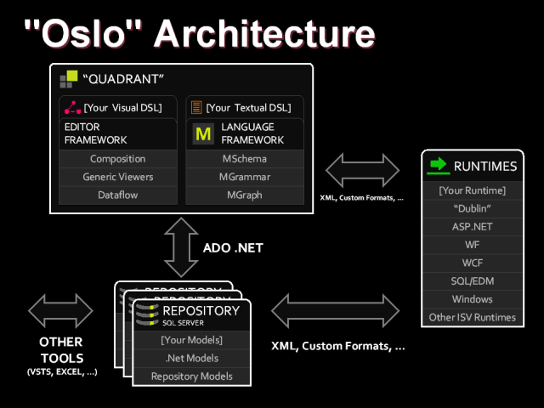

Slide 4
What is Microsoft ‘Oslo’?
  Difficult to define
  Connecting Visual and Textual DSLs and SQL Server on the stack
  Questionable merits/benefits
  An immature technology – ‘nascent’ (3rd CTP Preview)

Slide 5
An ‘Oslo’ Use Case:
<plug>bdUnit</plug>

Slide 6
What is Microsoft ‘Oslo’?
  Create a new language, parser and compiler…
  BDD Style DSL with C# Unit Tests output
  WPF IDE
  Agnostic Unit Tests -> Structure Map to the Rescue!

Slide 7
bdUnit IDE Demo

Slide 8
The Parser: MGrammar

Slide 9
MGrammar and Intellipad
  Intellipad
  Tokens and Syntaxes
  Language Projection(verb, noun, adjective...?)
  Syntax Delegation
  Functional Expressions

Slide 10
Intellipad Demo

Slide 11
MGrammar and Intellipad
  Intellipad
  Tokens and Syntaxes
  Language Projection(verb, noun, adjective...?)
  Syntax Delegation
  Functional Expressions

Slide 12
Low Level Projection
When a @User(Chris) ~Username is "chriscanal"
and a @Post(DSLs) ~Title is "An Evening of DSLs"
and @Blog(ScotAltNet) ~Author is Chris
and @User(Chris) #Publish a @Post(DSLs)
@Blog(ScotAltNet) should have more than 0 ~Entries
and @Blog(ScotAltNet) ~Entries should contain a @Post with DSLs ~Title
and @Post(DSLs) ~PublicationDate should be later than @Blog(ScotAltNet) ~CreatedDate
and @User(Chris) ~PostCount should be equal to 1
Object/Entity Token
Property Token
Method Token
Constraint Token
Operator Syntax
Value Syntax

Slide 13
MGrammar and Intellipad
  Intellipad
  Tokens and Syntaxes
  Language Projection(verb, noun, adjective...?)
  Syntax Delegation
  Functional aspects of MGrammar

Slide 14
Projection at a Higher Level
When a @User(Chris) ~Username is "chriscanal"
and a @Post(DSLs) ~Title is "An Evening of DSLs"
and @Blog(ScotAltNet) ~Author is Chris
and @User(Chris) #Publish a @Post(DSLs)
@Blog(ScotAltNet) should have more than 0 ~Entries
and @Blog(ScotAltNet) ~Entries should contain a @Post with DSLs ~Title
and @Post(DSLs) ~PublicationDate should be later than @Blog(ScotAltNet) ~CreatedDate
and @User(Chris) ~PostCount should be equal to 1
WhenStatement Syntax
TargetList Syntax
Constraint Syntax

Slide 15
MGrammar and Intellipad
  Intellipad
  Tokens and Syntaxes
  Language Projection(verb, noun, adjective...?)
  Syntax Delegation
  Functional Expressions

Slide 16
Pipeline Extensibility

Slide 17
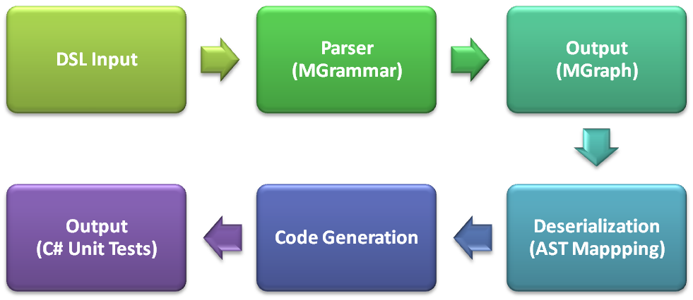
‘Oslo’ DSL Pipeline
‘M’ Language Framework and Tooling
You’re on your own!

Slide 18
bdUnit Project: http://assembla.com/spaces/bdunit
Blog: http://lynchjames.co.uk
Email: lynchjames@gmail.com
Twitter: lynchjames

